Slide 1
Software Engineering and Architecture
Compositional Design Principles

Slide 2
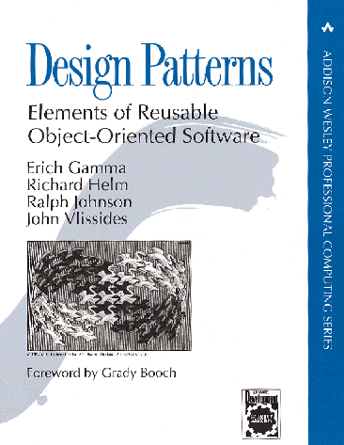
Gang of Four (GoF)
Erich Gamma, Richard Helm
Ralph Johnson & John Vlissides
Design Patterns – Elements of
Reusable Object-Oriented Software
Addison-Wesley, 1995.
(As CD, 1998)
First systematic software pattern description.

Slide 3
The most important chapter
Section 1.6 of GoF has a section called:
How design patterns solve design problems
This section is the gold nugget section
It ties the patterns to the underlying coding principles that delivers the real power.

Slide 4
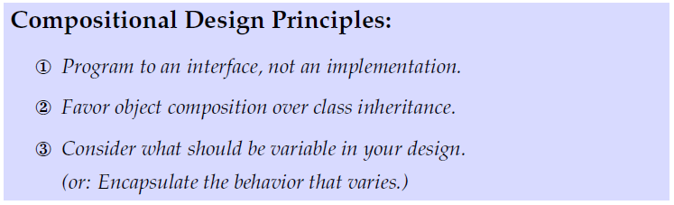
Compositional Design Principles

Slide 5
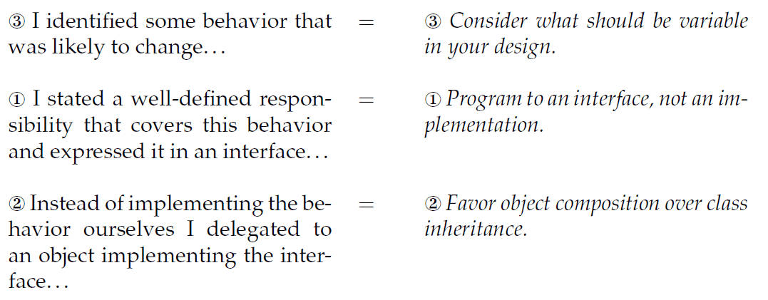
As the 3-1-2 process

Slide 6
First Principle

Slide 7
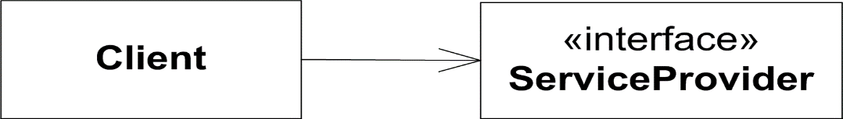
GoF’s 1st principle
Program to an interface, not an implementation
In other words
Assume only the role
(the responsibilities + protocol)
… and never allow yourself to be coupled to implementation details and concrete behavior

Slide 8
First Principle
Program to an interface because
  You only collaborate with the role – not an individual object
  You are free to use any service provider class!
    Any class that implements that interface…
  You do not delimit other developers for providing their service provider class!
  You avoid binding others to a particular inheritance hierarchy
    Which you would do if you use (abstract) classes…

Slide 9
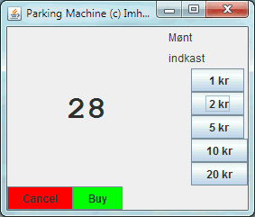


Example
Early pay station GUI used JLabel for visual output
I only use method: ’setText()’
Notes:
I found this GUI in sa-E05

Slide 10
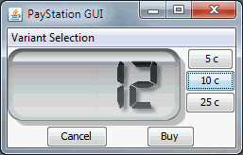

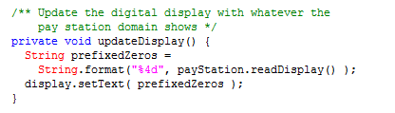
Example
The I found SoftCollection’s number display, got permission to use it, but...
... And use:

Slide 11
Morale
It would have been easy to make the code completely identical, and thus support full reuse, in which I simply configure PayStationGUI with the proper ’text panel’ to use.
But I cannot!
  Because LCDDigitDisplay does not inherit JLabel!!!
Thus instead of dependency injection and change by addition I get
Change by modification
  I have to start my editor just to change one declaration!
  I can never get a framework out of this!

Slide 12
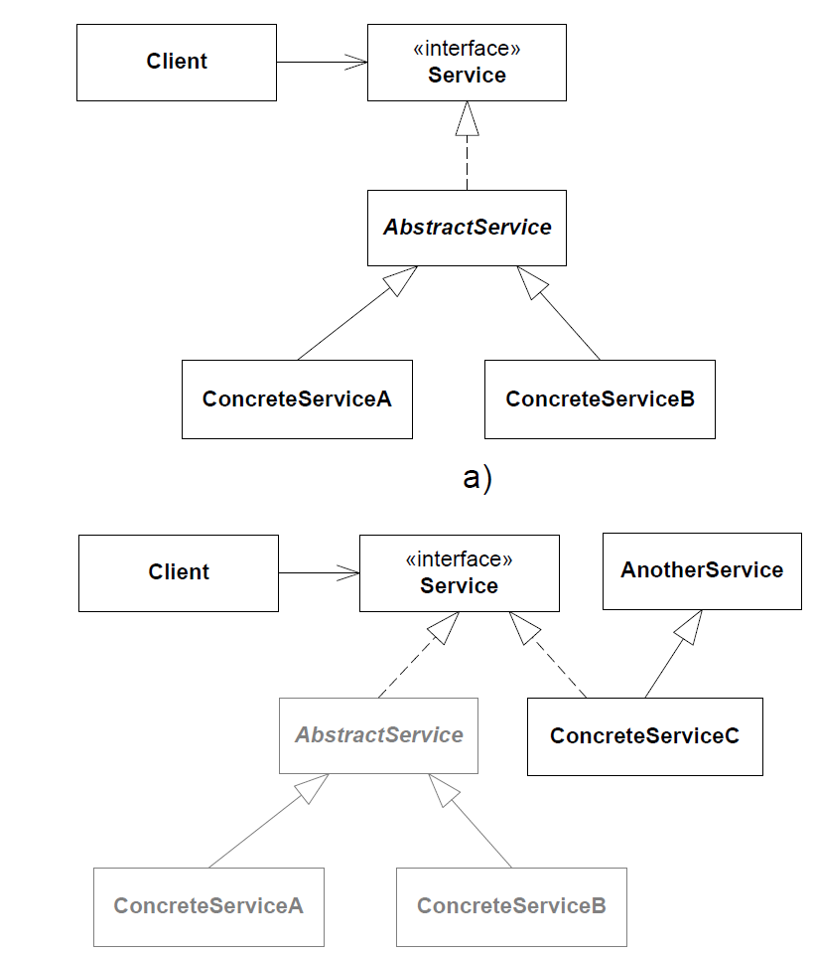
Could have been solved…
If JLabel was an interface instead!
  Interface “IJLabel”
  setText(String s);
Then there would be no hard coupling to a specific inheritance hierarchy.
GUI
IJLabel
LCDDigitDisplay
JLabel
MyLCDDigitDisplay

Slide 13
Interfaces allow fine-grained behavioral abstractions
Clients can be very specific about the exact responsibility it requires from its service provider – Role interfaces
Example:
  Collections.sort(List<T> list)
  can sort a list of objects of any type, T, if each object implements the interface Comparable<? super T>
  i.e. must implement method ‘int compareTo(T o)’.
Low coupling – no irrelevant method dependency!
SOLID : I = Interface Segregation

Slide 14

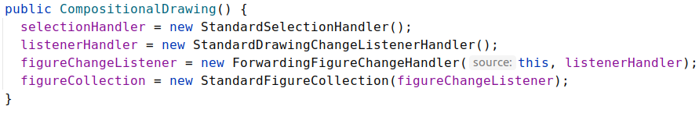
Interfaces better express roles
Interfaces express specific responsibilities whereas classes express concepts. Concepts usually include more responsibilities and they become broader!
Small, very well defined, roles are easier to reuse as you do not get all the “stuff you do not need...”

Slide 15
Second Principle

Slide 16
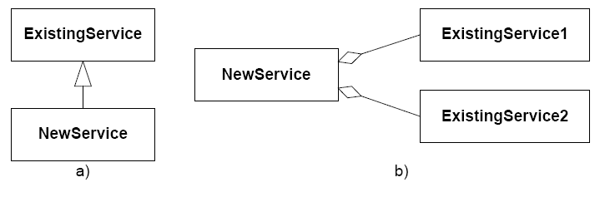
GoF’s 2nd principle
Favor object composition over class inheritance
What this statement says is that there are basically two ways to reuse code in OO!
And the compositional one should be favored!

Slide 17
Benefits of class inheritance
Class inheritance
  You get the “whole packet” and “tweak a bit” by overriding a single or few methods
    Fast and easy (very little typing!)
    Explicit in the code, supported by language
      (you can directly write “extends”)
But...

Slide 18
Encapsulation
“inheritance breaks encapsulation”
Snyder (1986)

Slide 19
Why?
No encapsulation because
  Subclass can access every…
    instance variable/property
    data structure
    Method
  … of any superclass (except those declared private)
Thus a subclass and superclass are tightly coupled
  You cannot change the root class’ data structure without refactoring every subclass in the complete hierarchy ☹

Slide 20
Only add responsibilities, never remove
You buy the full package!
  All methods, all data structures
  Even those that are irrelevant or down right wrong!

Slide 21

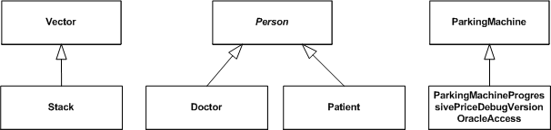
Example
Vector<E> (= an ArrayList ‘almost’)
  void add(int index, E element)
Stack<E> extends Vector<E>
  E pop()
  void push(E item)
Argue why this is a design with many liabilities?
How can you rewrite it elegantly using composition?
Notes:
Vector<E> is a synchronized ArrayList.
Push(e) {add(e);} pop { e=get(last); remove(last--); return e;}

Slide 22
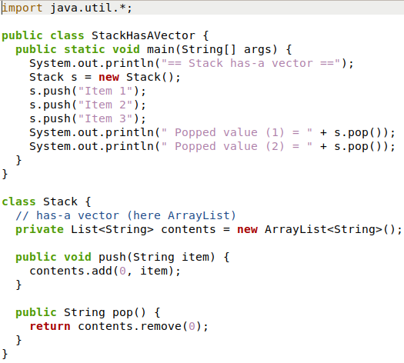

Rewriting to Composition
Class ‘Stack has-a Vector’, instead of ‘Stack is-a Vector’
  Much better design!
    Stack does not have any
    Vector/List methods, only
    push() and pop()

Slide 23
Compile time binding
The binding between Stack and Vector is a compile time binding
  You write ‘extends’ in the code
  The only way to change behavior in
  the future (tweak a bit more) is through
  the edit-compile-debug-debug-
  debug-debug cycle

Slide 24
Loose binding
The Compositional approach has a loose coupling
  [I have hardwired it to ArrayList below, but I could dependency
  inject any other implementation
  of List<String>!]
Any implementing class of List<String> can be substituted here (by Dependency Injection), thus no hard coupling between Stack and “Vector”

Slide 25
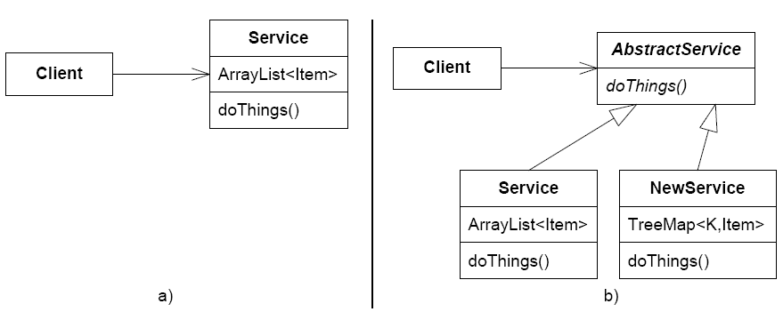
Recurring modifications
Constantly bubbling of behavior up into the root class in a hierarchy
  Review the analysis in the State pattern chapter
Another example
  Nice service based upon ArrayList
    Now – want better performance in new variant
  All three classes
  modified ☹

Slide 26
Separate Testing
Often, small and well focused abstractions are easier to test than large classes
  a) Only integration testing possible (NewS. + ExistS.)
  b) Allows unit testing of ‘ExistingService1+2’,
  and often unit testing of NewService, by replacing collaborators with Test Stubs ala StubService1 and StubService2

Slide 27
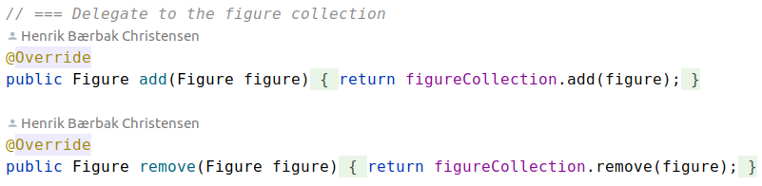
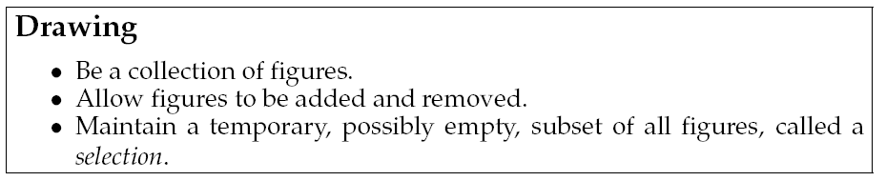
Increase possibility of reuse
Smaller implementations are easier to reuse
Example from MiniDraw
  Sub responsibility
Allow compositional reuse of FigureCollection in all present and future impl. of Drawing!

Slide 28
Liabilities
Increased number of abstractions and objects ☹
Delegation requires more boiler-plate code ☹

Slide 29
(what is he saying???)
Inheritance is an interesting construct, but
  It often leads to lesser designs ☹
It does not elegantly handle
  ad hoc reuse
  modelling roles
  variance of behavior

Slide 30
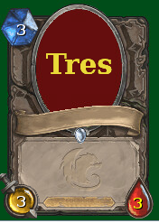


When to use Inheritance?
My rule of thumb
  Iff there is behavioral differences between subclasses
    Not just parameters and constants; it must be different algorithms
  Iff you are absolutely sure there will be only one dimension of variability and a shallow inheritance tree…
Often, I later find I can rewrite inheritance…
  E2023
  E2024
    Gfx rendering difference is just a set of
    parameters… See slides in Week 9 ☺…

Slide 31
Third Principle

Slide 32
GoF’s 3rd principle
Consider what should be variable in your design
[GoF §1.8, p.29]
Another way of expressing the 3rd principle:
Encapsulate the behavior that varies

Slide 33
Analysis
This statement is closely linked to the shorter
Change by addition, not by modification
That is – you identify
  the design/code that should remain stable
  the design/code that may vary
and use techniques that ensure that the stable part – well – remain stable
These techniques are 1st and 2nd principle
  most of the time ☺

Slide 34
The Principles In Action

Slide 35
Principles in action
Applying the principles lead to basically the same structure of most patterns:
  New requirement to our client code
Client

Slide 36
Principles in action
Applying the principles lead to basically the same structure of most patterns:
③ Consider what should be variable
Client
Variability

Slide 37
Principles in action
Applying the principles lead to basically the same structure of most patterns:
① Program to an interface
Client
«interface»
Variability

Slide 38
Principles in action
Applying the principles lead to basically the same structure of most patterns:
② Favor object composition
Client
«interface»
Variability
ConcreteVariation1
ConcreteVariation2

Slide 39
And that is why…
… most patterns follows this structure exactly
  They encapsulate variability and favor composition
Client
«interface»
Variability
ConcreteVariation1
ConcreteVariation2

Slide 40
Summary
③ We identified some behaviour that was likely to change…
① We stated a well defined responsibility that covers this behaviour and expressed it in an interface
② Instead of performing behaviour ourselves we delegated to an object implementing the interface
③ Consider what should be variable in your design
① Program to an interface, not an implementation
② Favor object composition over class inheritance

Slide 41
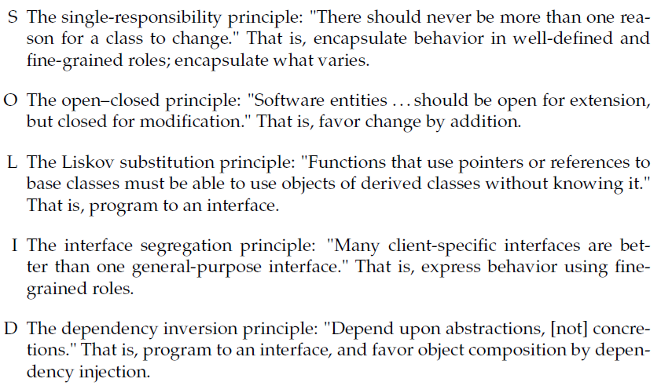
SOLID
A more well-known set of principles than③①②, but states more or less the same…

Slide 42
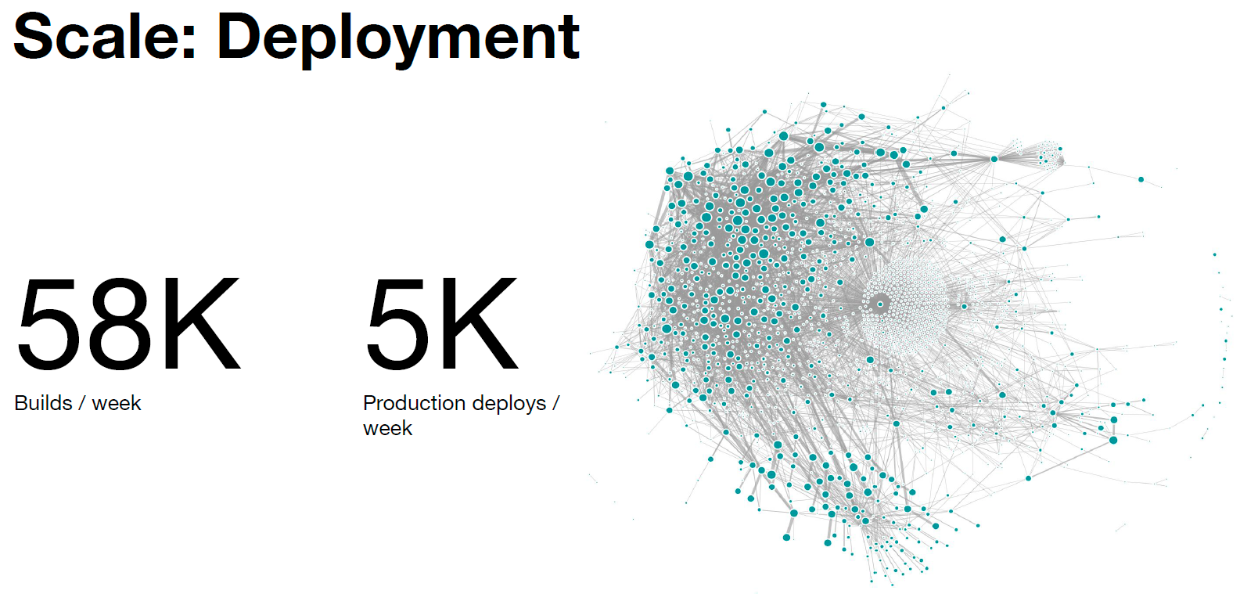
SOLID is Solid
An architectural style for large systems: Microservices
  Key architecture for Uber, Google, NetFlix, …
Lots of tooling, lots of architectural tactics, lots of design doctrines to follow, but…
At the core, it is..
  Design with high cohesion and low coupling
  Design according to SOLID
  Program to an interface, favor object composition
Uber Data

